Slide 1

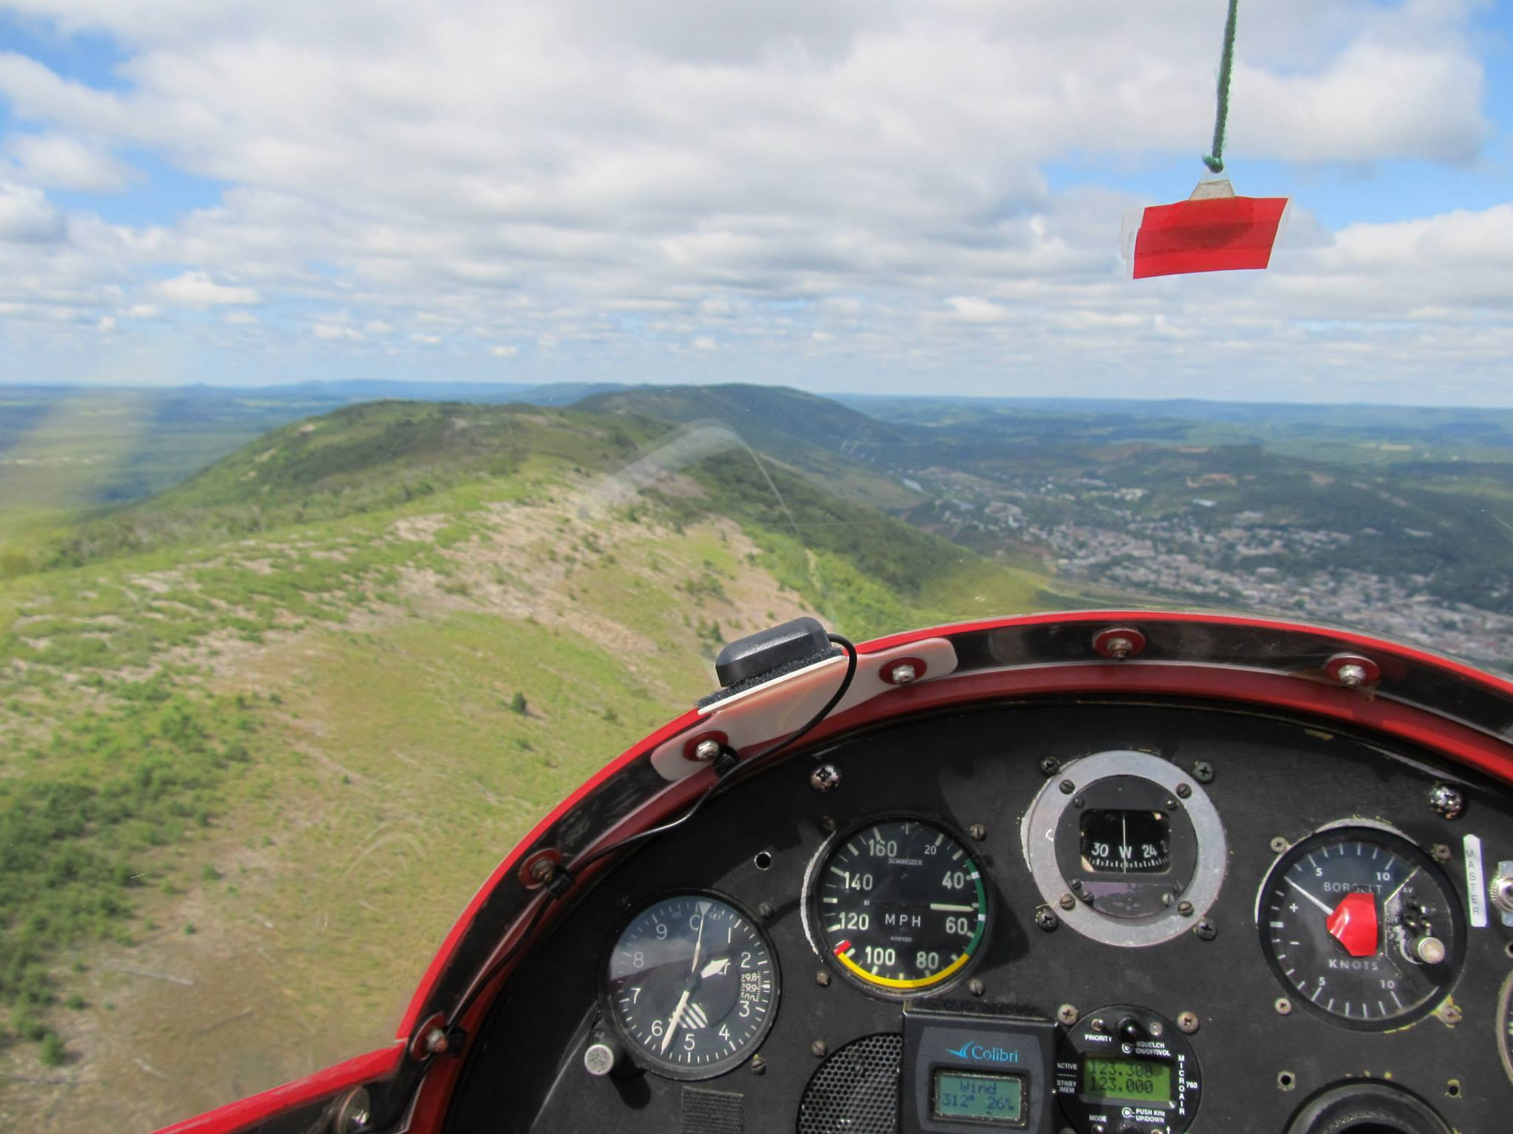
Preparation Tools for Ridge Soaring
By: Daniel Sazhin

Slide 2
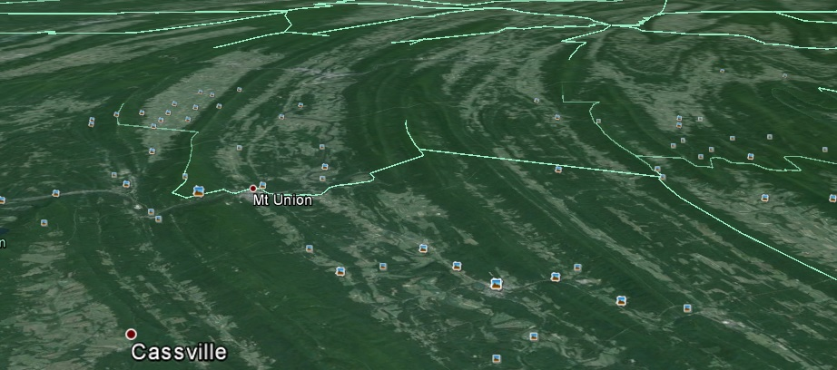
Situational Awareness
Knowing where you are and where you want to be. Furthermore, knowing what “troubles” are awaiting.
In other words, “ahead of the curve”

Slide 3

Speaking of which!
How many of you have followed a curving ridge and fell off due to suboptimal wind direction?
How many of you got disoriented while flying a ridge? Got lost?
Flew the wrong ridge?
http://aviationhumor.net/wp-content/uploads/2012/12/Damn-you-apple-maps.jpg

Slide 4
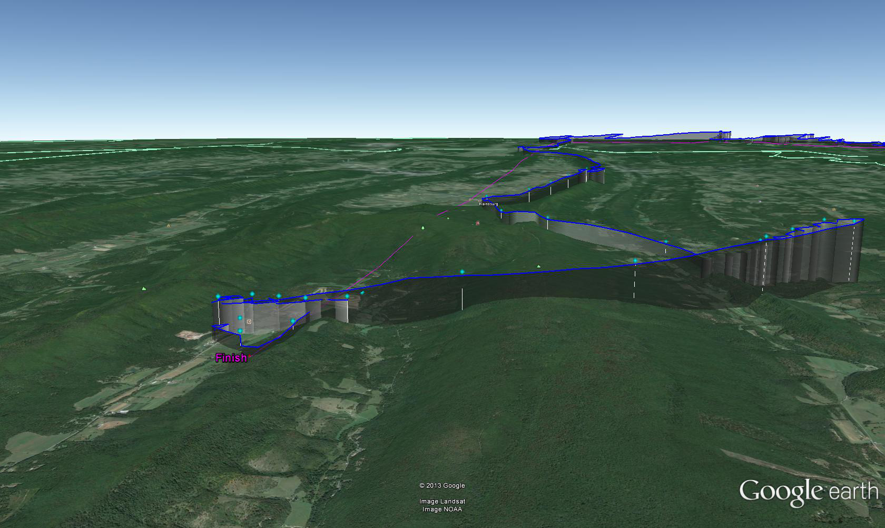

Slide 5

Solution!
Preparation, preparation, preparation! There are multiple tools out there that can teach you how to be ahead of the curve without having hundreds of hours of flying experience.
Note of caution- Assumed that pilot knows how to fly ridge and thermals
http://www.psealocals.org/sharedimages/General/

Slide 6
What to look for
Ridges flown
Names of landmarks and ridges.
Note wind drift... direction and how strong drift is.
Altitude used before transitions
(Un)landable areas (Note: Google Earth and other satellite features are not a guarantee of a field's situation, though slope and size is accurate.)
Optimal wind direction for a ridge

Slide 7
OLC
Quickest method of analysis.
Google-maps terrain view is most useful.
Best if one continously follows flights done out of MASA/Mifflin/Ridge Soaring/Blairstown
Ideal if you have access to mentor to discuss why he did something. (Appalachian Ridge Soaring group is excellent for this purpose)
Pay special attention to transitions, altitudes, etc.

Slide 8
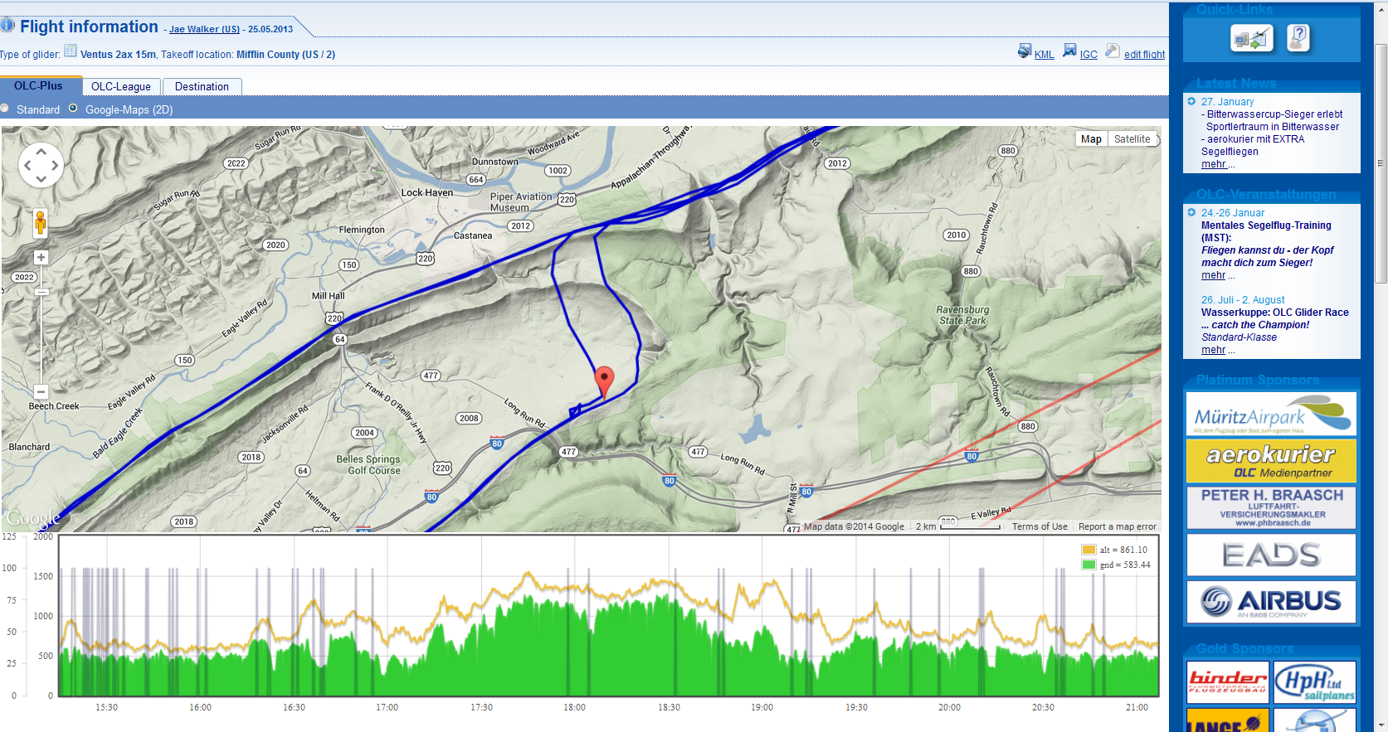
http://www.onlinecontest.org/olc-2.0/gliding/flightinfo.html?dsId=2997716

Slide 9
Sielicki's Ridge Map
Fantastic tool for learning ridge names and useful landmarks
Use terrain map overlay
Most turnpoints, especially in the Mifflin/Blairstown area have descriptions if you click on them

Slide 10
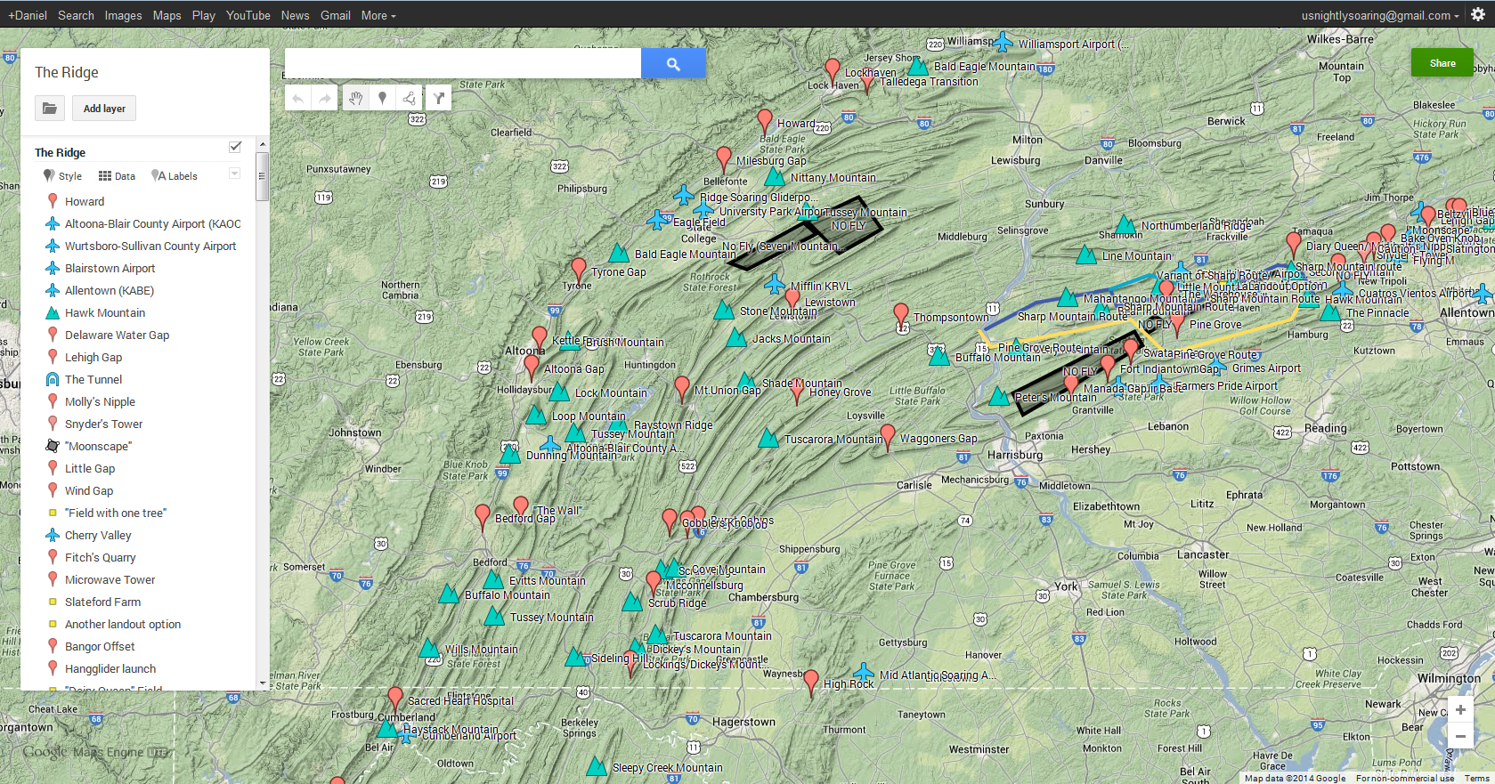
https://mapsengine.google.com/map/u/0/edit?mid=zvgBN5F6QW2Y.kKm1AE_RXNe0

Slide 11
IGC Tools
SeeYou and IGC Flight Replay.
IGC Flight Replay puts you “in the cockpit.”
Excellent for visualizing angles and getting a better perspective.
Simply download IGC track from OLC or from SSA page.

Slide 12
KML Tool
Interactive view of whole flight in Google Earth.
Simply click on “KML” on OLC
Angles very apparent in transitions
General tip- use “ruler” tool and note 90 degree angles for ridges. Good for understanding optimal direction
Excellent for looking at landing options

Slide 13
KML Tool
Interactive view of whole flight in Google Earth.
Simply click on “KML” on OLC
Angles very apparent in transitions
General tip- use “ruler” tool and note 90 degree angles for ridges. Good for understanding optimal direction
Excellent for looking at landing options

Slide 14
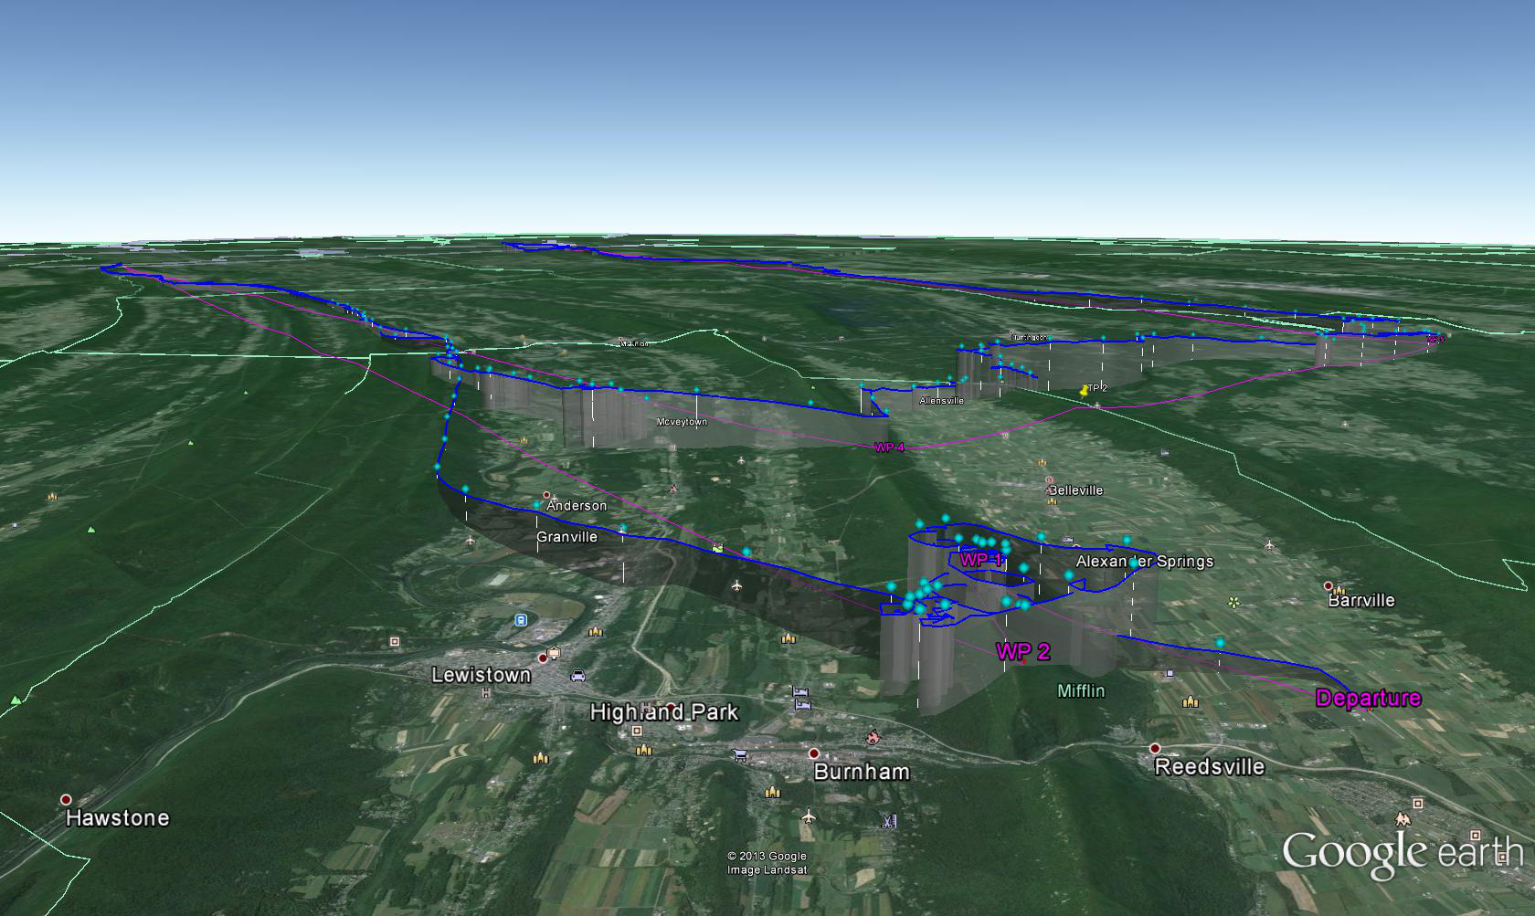

Slide 15
Condor!
Put your knowledge learned from previous tools to the test!
Explore transitions
Experience similar problems, like falling off ridges, getting lost, etc.
Learn contours and layouts of ridges
Experience different wind directions and how they affect decision making
Fly with other pilots competitively

Slide 16


Slide 17


Slide 18


Slide 19
Limitations
Doesn't simulate suppression of any kind (wave, orographic or thermal). This means shadowed ridges work.
Field selection is omitted
Streeting is poorly simulated (sorta).
Transitions that require thermalling are more difficult than in reality.

Slide 20
Conclusion
If you make a consistent effort to use at least some of these preparation tools, you will:
Be safe
Be competitive
And most importantly have fun!

