Slide 1

Off Airport Landings
Aero Club Albatross
September 15, 2018
10:00 Hours
Warren Country Library
Blairstown, New Jersey

Slide 2
Why You Should Be Prepared
Any glider flight can end in an off airport landing.
  Unexpectadly end up out of gliding distance.
  Coming up short of home airport.
Cross-country soaring sometimes results in landing away from home.
All off airport landings have higher risk

Slide 3
Caveats
These are broad generalizations
There are a million “depends”.
Impossible to cover all the factors that go into a safe landout.

Slide 4
Why Higher Risk?
Bad field selection
Bad approach/pattern:
  Undershoot/overshoot.
Loss of control in the pattern.
Possibility of serious damage or injury!
Otherwise, minor damage possible, but low risk.

Slide 5
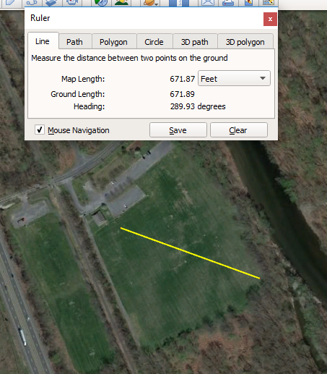
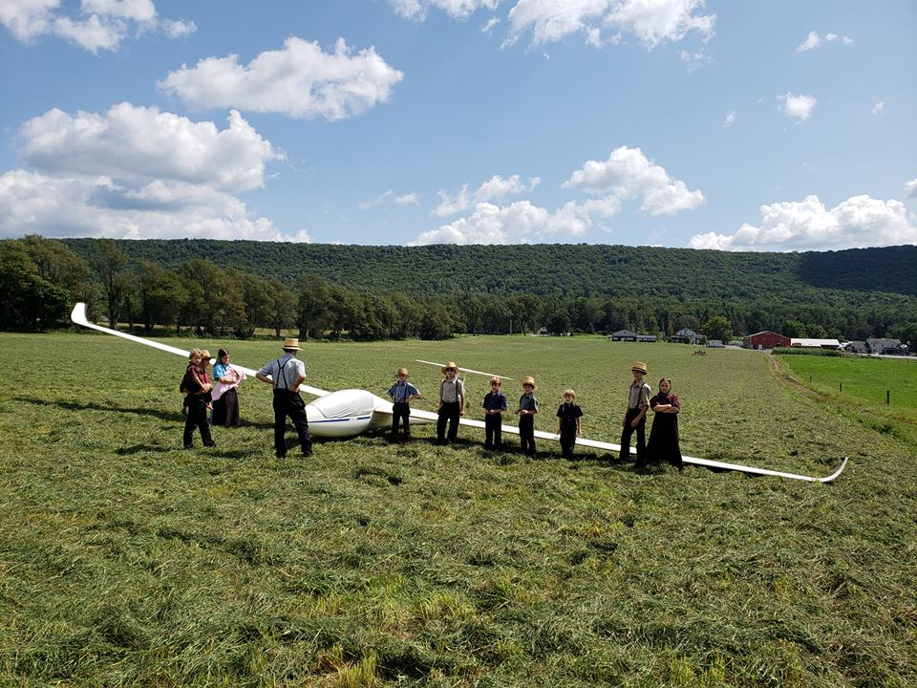
Fields are not created equal!

Slide 6
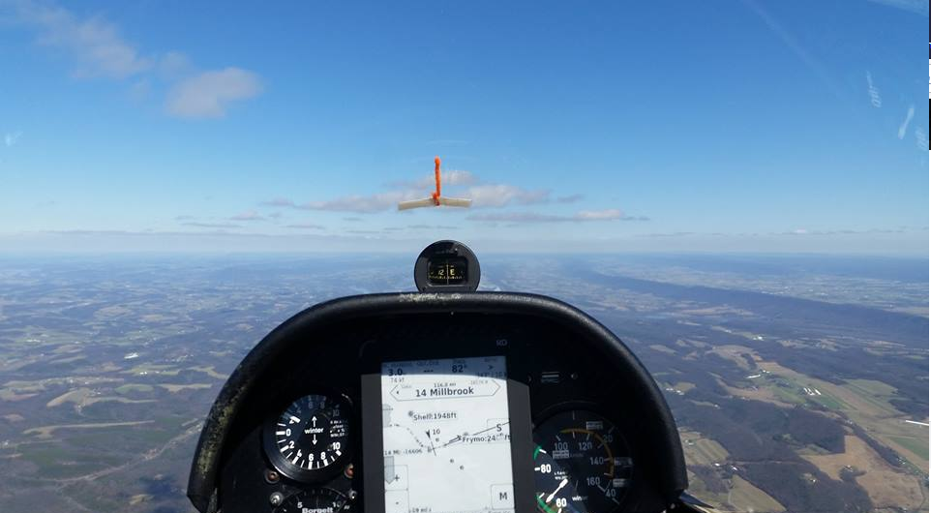
Situational Awareness (1/4)

Slide 7
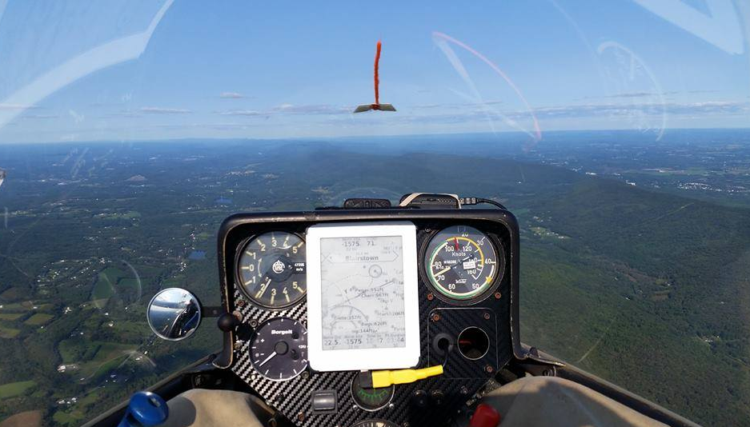
Situational Awareness (2/4)

Slide 8
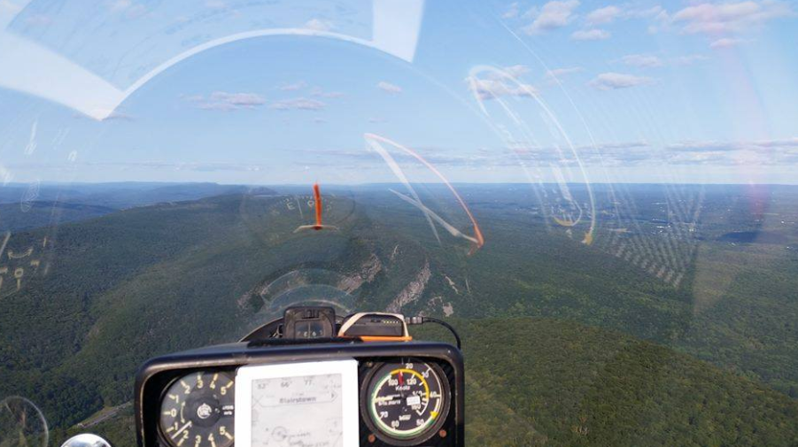
Situational Awareness (3/4)

Slide 9
Situational Awareness (4/4)
Judging GLIDE ANGLE
Train, train, train!!!
Judging PRIORITIES!
Deviate early
Have many options
Don't box yourself in!

Slide 10
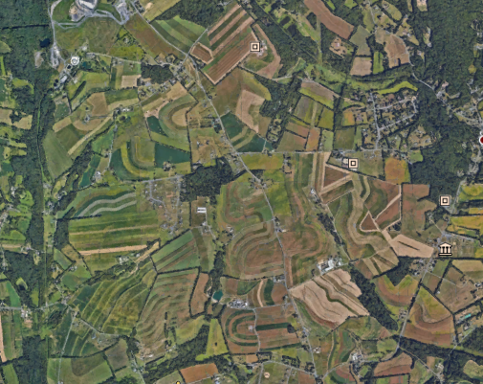
Field Selection

Slide 11
Field Selection
Slope
Surface
Obstacles
Wind
Judge these things well, easy. Not, then you can be in serious trouble!

Slide 12
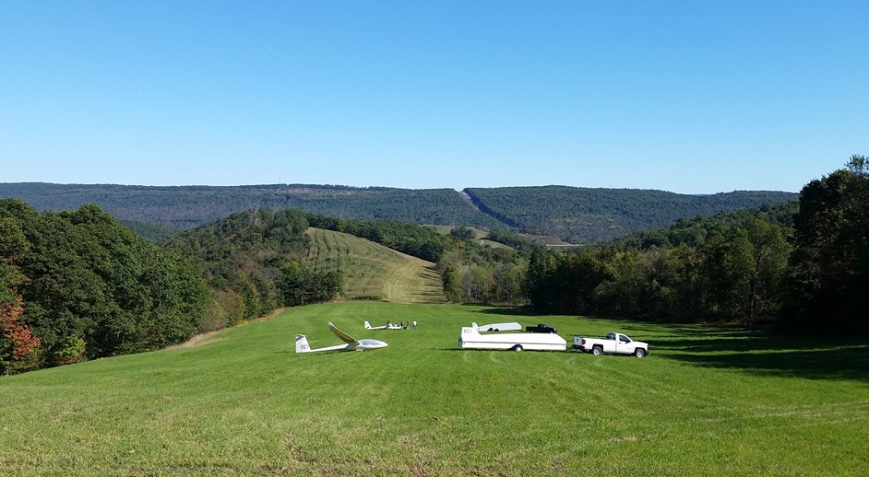
Slope

Slide 13
Serious Hazards
Slopes
SLOPE
Cross slope landings
  Avoid if possible!
  Make final in a turn to match the slope
  Touch down MUST be on the upward portion of the slope

Slide 14
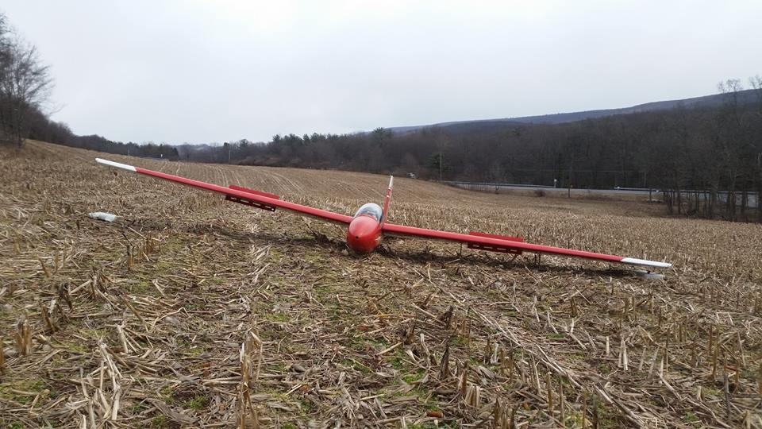
Cross Slope (1/2)

Slide 15
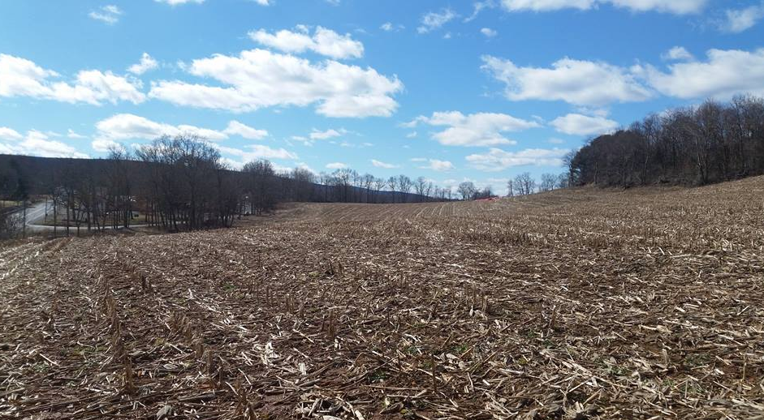
Cross Slope (2/2)

Slide 16
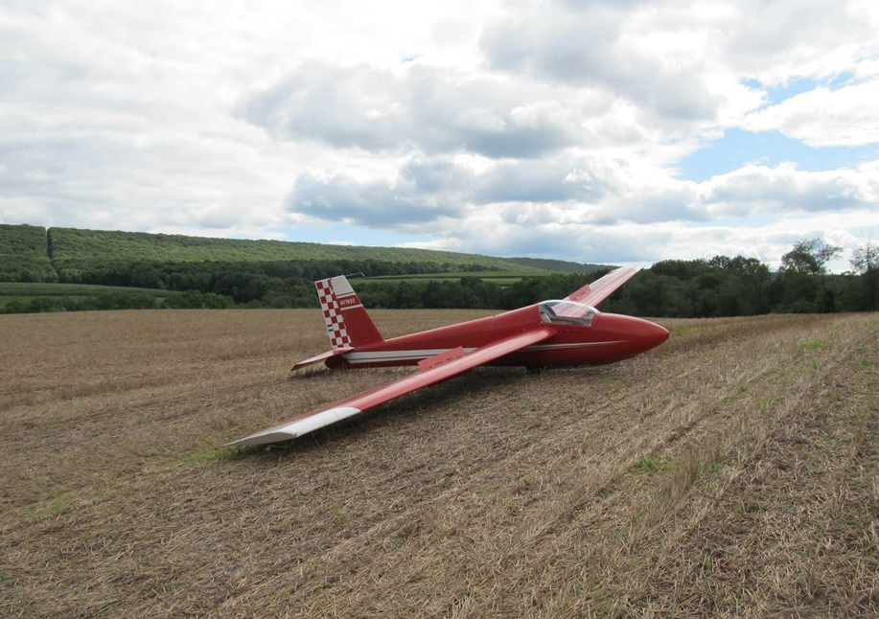
Surface

Slide 17
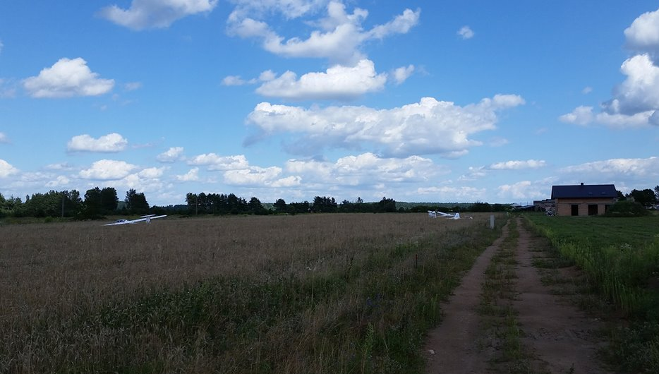
Bad Surface

Slide 18
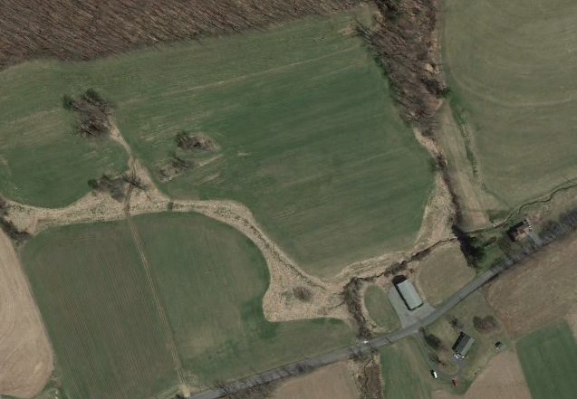
Obstacles- Ditches and Fences (1/2)

Slide 19
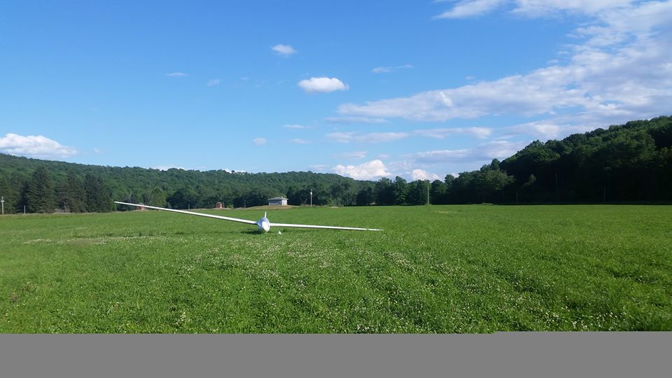
Obstacles: Wires (2/2)

Slide 20
Serious Hazards: Wires
Between two poles
Between a pole and tree(s)
Between a road and a house
Above any road
Going to any kind of building
Watch out in narrow fields (lines crossing)
Assume wire surround any field

Slide 21
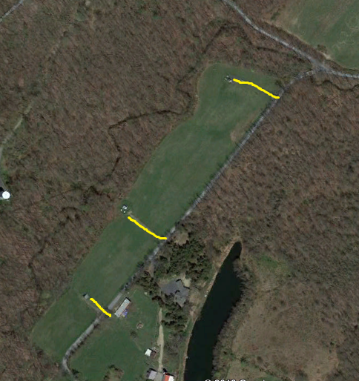
Wires 2/2

Slide 22
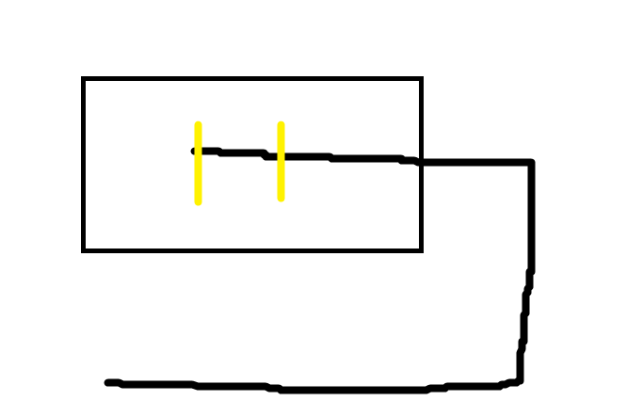
Pattern (1/3)

Slide 23
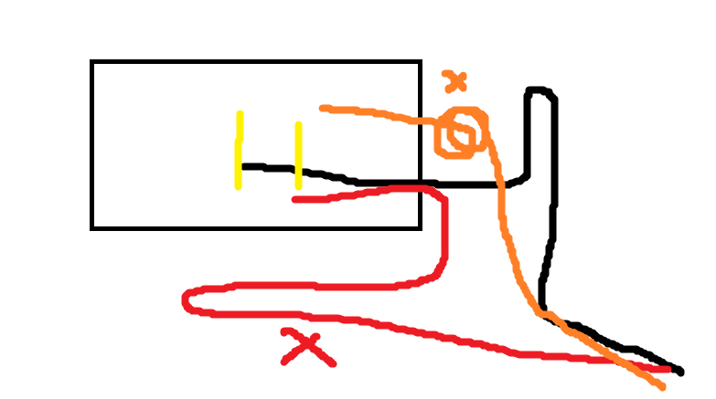
Pattern When Low (2/3)

Slide 24
Pattern and Approach
HIGH
Fly a five leg pattern view the field from all angles
  Upwind, Crosswind, Downwind, Base, Final
Plan to land well into the field
Avoid approaches with tall obstructions
Good speed control is imperative!
Use ‘reverse pattern’ if you are too high on base

Slide 25
Approach/Pattern (3/3)
Don't do anything you haven't trained before.
Make a pattern.
Steep, close and fast (if practicable)

Slide 26
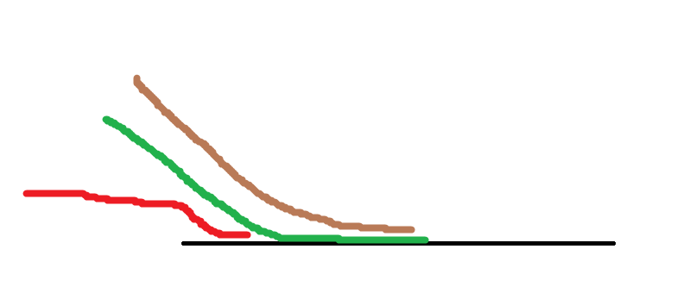
Final Approach

Slide 27
After Landing
Dehydrated
Stressed
Exhausted
Glucose depleted
Retrieve is tricky business!
Get as much done before crew gets there.
Do everything one step at a time.
Give yourself an extra 15 minutes.

Slide 28
Low Saves
Don't do anything you haven't trained before.
Dangerous:
  High stress: Time pressure, ego pressure. Divided attention.
  You don't make good decisions when you're stressed.

Slide 29
Training!
Spin Proficiency
Precision Patterns
Patterns without reference to the altimeter
Lessen your dependence on the ASI
Precision landings
Don't be cute. Don't do anything you haven't
Practiced!

