Slide 1
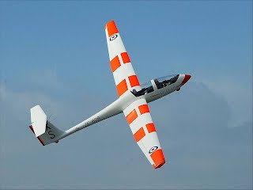
By: Ron Schwartz and Daniel Sazhin
Competition Soaring and Condor
http://www.1260sqn.co.uk/about-us/the-air-cadet-organisation/the-history-of-the-atc

Slide 2
Competition Soaring: What is a Competition?
The nature of glider flying is energy management.
A competition is the measure of how efficiently pilots are able to harness the vertical energy of the atmosphere and convert it to fast speeds.
Spirit of competing is to maximize your own performance and compare it others. It is very hard to gauge how efficiently one is flying unless it is in comparison to others.

Slide 3
Before Flight
There's a lot of things that go on before we fly on a contest day!
Pilot's meeting
Personal preparations (Getting task on GPS/food/water/piss bags etc)
Gridding
Sniffer

Slide 4
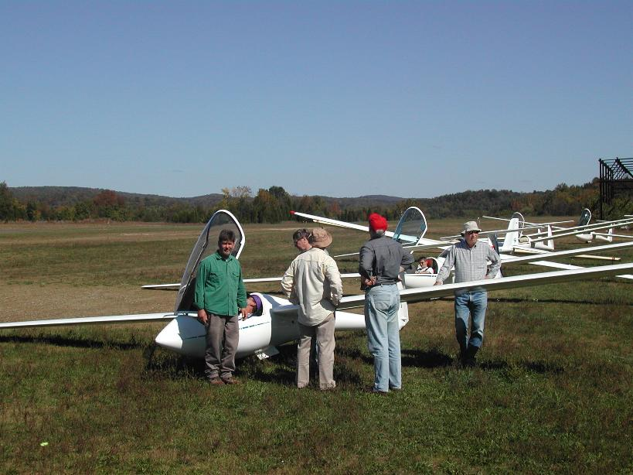
http://www.aeroclubalbatross.org/Images/BigGrid_lg.jpg

Slide 5
Pre-Start
Once you have launched, you must wait until the Start gate is open
The gate usually opens 15 minutes after the last glider is launched
The first tactical decision a pilot must make is deciding when to start.

Slide 6
Now for the fun part!
After the start, we have to make a myriad of decisions to be able to fly most efficiently
In most competitions and especially on weak days, gaggling is common.
We must choose the best routes to follow in order to minimize the height lost in glides, and to find the best thermals.
We try to find “energy lines”

Slide 7
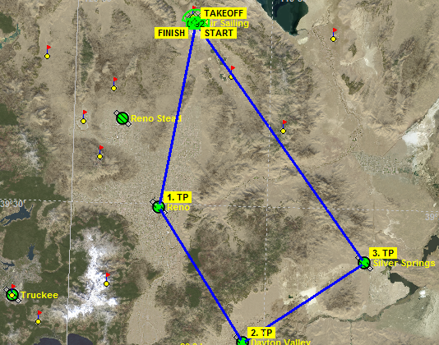
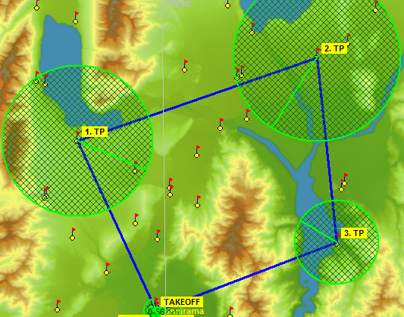
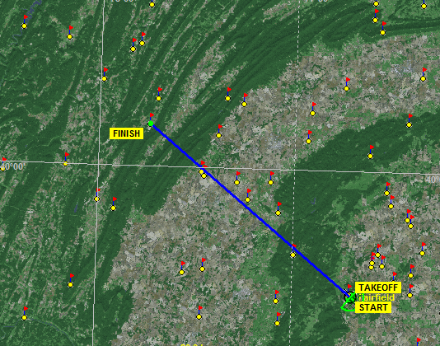
Tasks
Assigned Task
Turn Area Task (Assigned Area Task)
Modified Assigned Task

Slide 8
Flying Efficiently
It is important to have a good start
Fly as straight as possible/ minimize control input
Stay upwind of course-line
Stay in Height Band!
Thermal as least as possible going upwind and always try to leave a downwind turnpoint up high
Course Deviations
Final glide management

Slide 9
Speed to Fly
McCready Theory-
  Predict next thermal strength and set the dial
  Polar is non-linear. MC Theory takes advantage of this
  Framework of decision making.
Block Speeds
  Pick a speed and fly it.
In lift, slow down and in sink speed up.

Slide 10
Ridge Competition
Transitions transitions transitions! Will I make it?
When do you thermal off of a ridge to go for a turnpoint?
Always have a back door. Very few experiences are as eventful as a landout after a botched transition.

Slide 11
The End!

