Slide 1
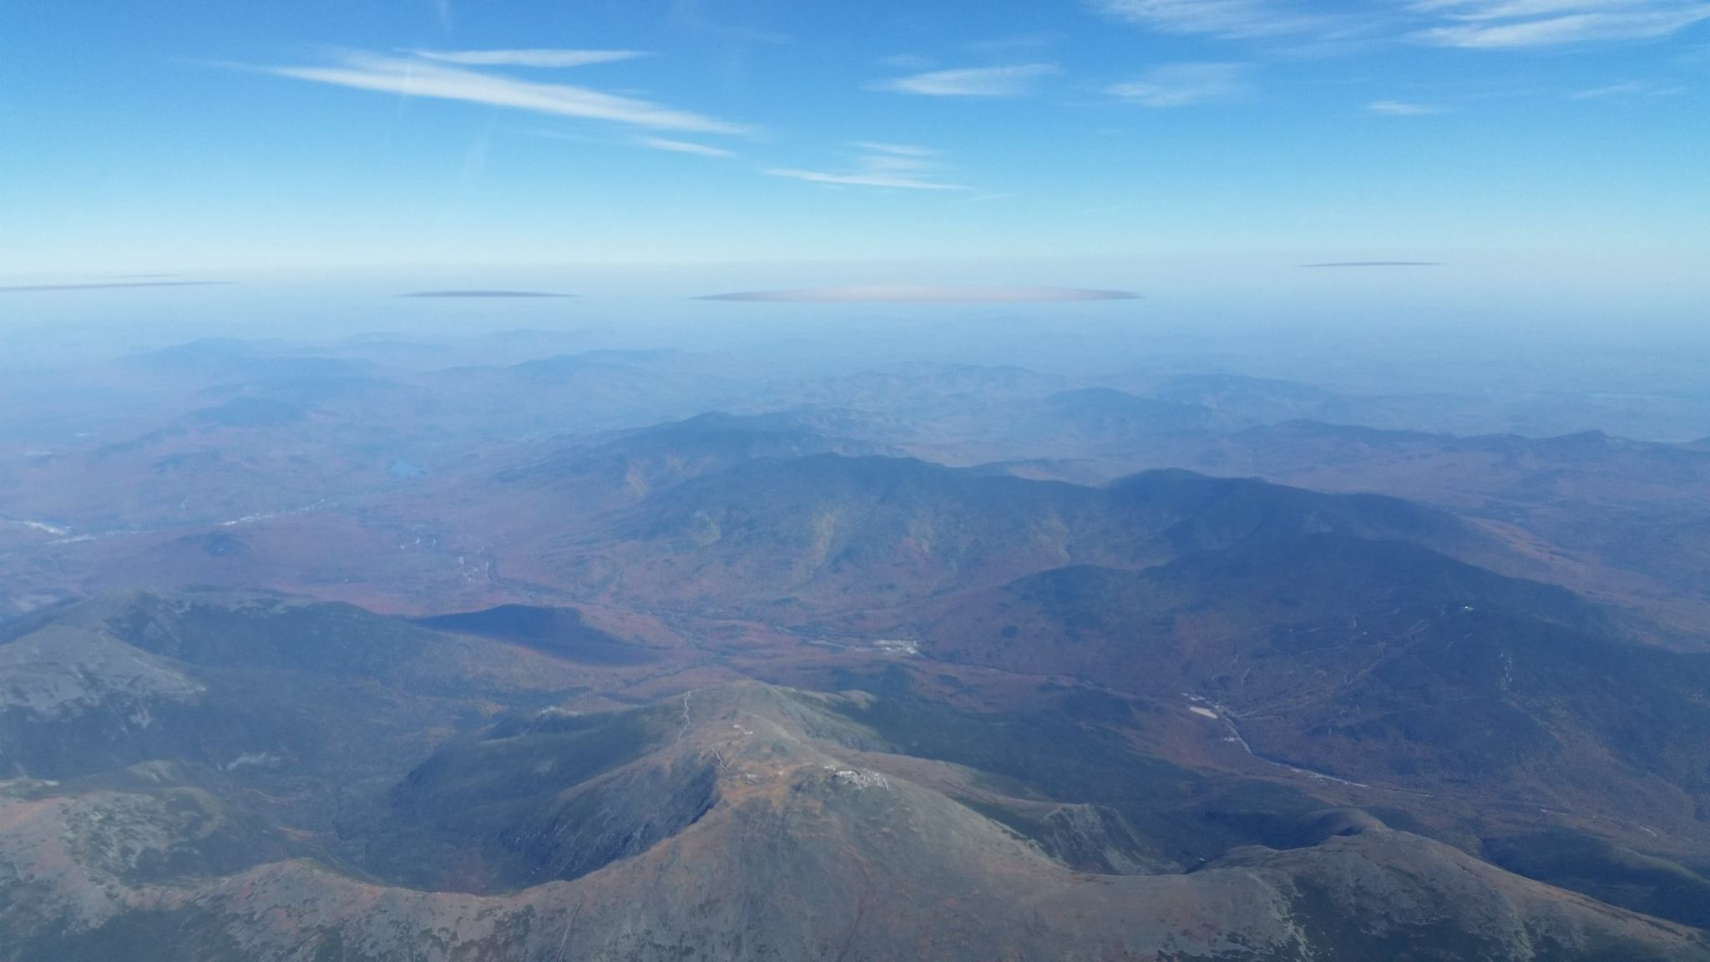
Soaring Weather
By: Daniel Sazhin

Slide 2
Objectives and Caveats:
What constitutes a “good” soaring day at Blairstown
How to choose your day 48 hours out.
Understand the outputs of weather forecasts
What this is not: A meteorology lesson
Geared so that everyone here can learn something and appreciate what
a special soaring site this is. If things go over your head, don’t worry!
The presentation provides the tools, but you must practice to get good!
Please leave questions until the end. We have a lot to cover.

Slide 3
Sparknotes version of a good soaring day:
Not SW
Post-frontal conditions: Instability
Wind Direction: Does it have an N in the wind?
Dewpoint spread: 4.5 degrees/1000
Careful! Clouds? May be an inversion.
When you get out, check for Daniel’s puddle.
20- 30 degree dewpoint spread, “mostly sunny or partly cloudy”,
  drop in temperature and generally W to N winds → 4500-6000ft CB
  These are the classic conditions for Blairstown soaring

Slide 4
Basic Tools:
Windmapper.com
Weather.gov
Usairnet: Allentown/ Mount Pocono
TAFs- KABE, etc

Slide 5
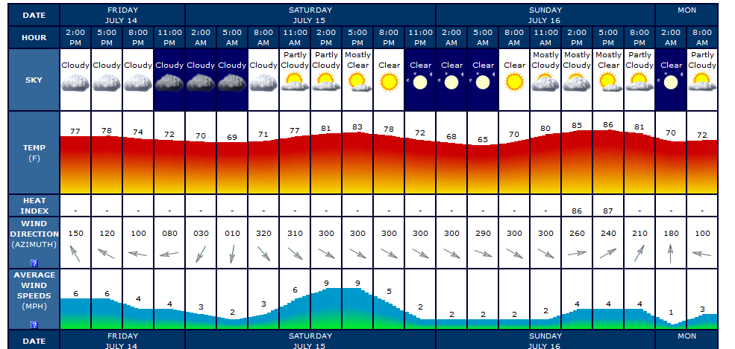
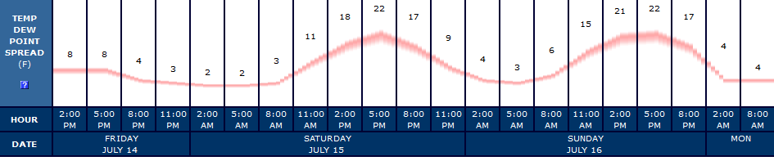
USAirnet (GFS)

Slide 6
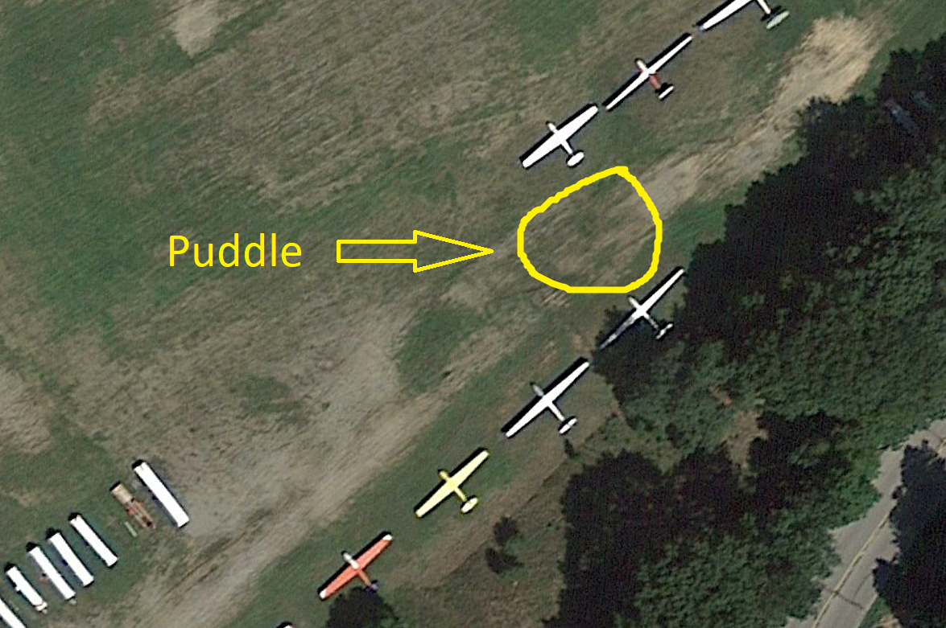

Slide 7
More Advanced Thermal Forecasting (1/2)
Dr. Jack (NAM)
  Thermal strength- (Homogeneity, strength)
  Boundary Top
  Cloudbase
  Wind Direction
  Convergence?
  Check 21Z!

Slide 8
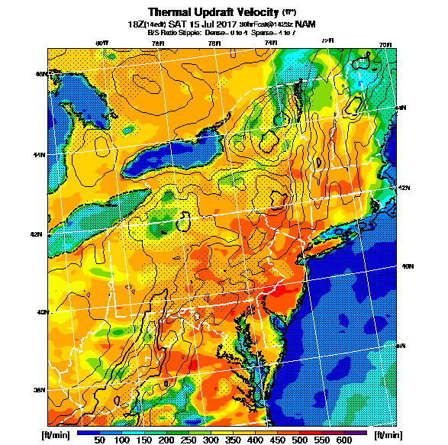
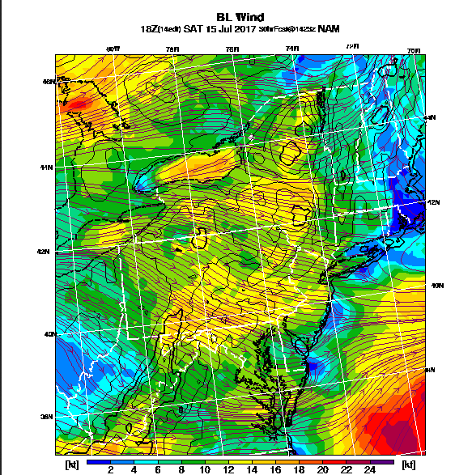

Slide 9
More Advanced Thermal Forecasting (2/2)
Skysight.io (Scutter’s model. Blend of GFS and NAM?)
  Good for convergence!
XCSkies
  European Model
  Very high resolution NAM
  GFS
These models do what Dr.Jack does, but better. They also provide
forecast soundings for those respective models.
Rain data: https://water.weather.gov/precip/

Slide 10
Speaking of Convergence….
What do we look for:
High pressure day, reasonably high boundary layer (5000ft+)
Wind from NE to SW. Less than seven knots
Works over the ridge, best over Catskills
Sometimes we get seabreeze convergence, but this is rare.
NE winds may create awesome streeting down the valley.
  Might be convergence influenced?

Slide 11
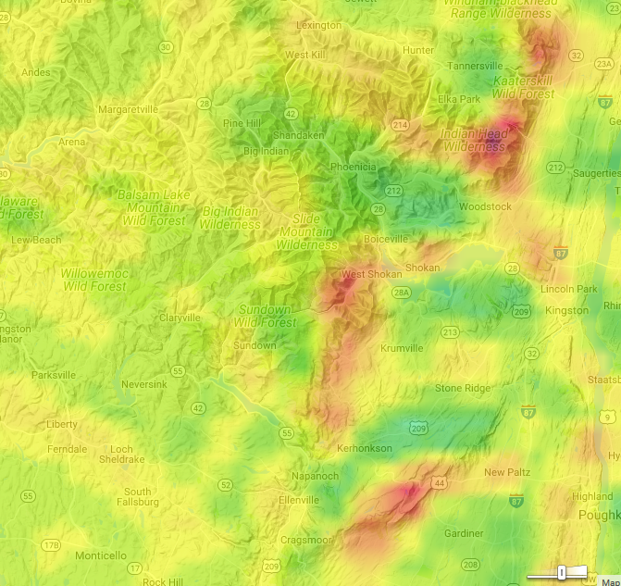

Slide 12
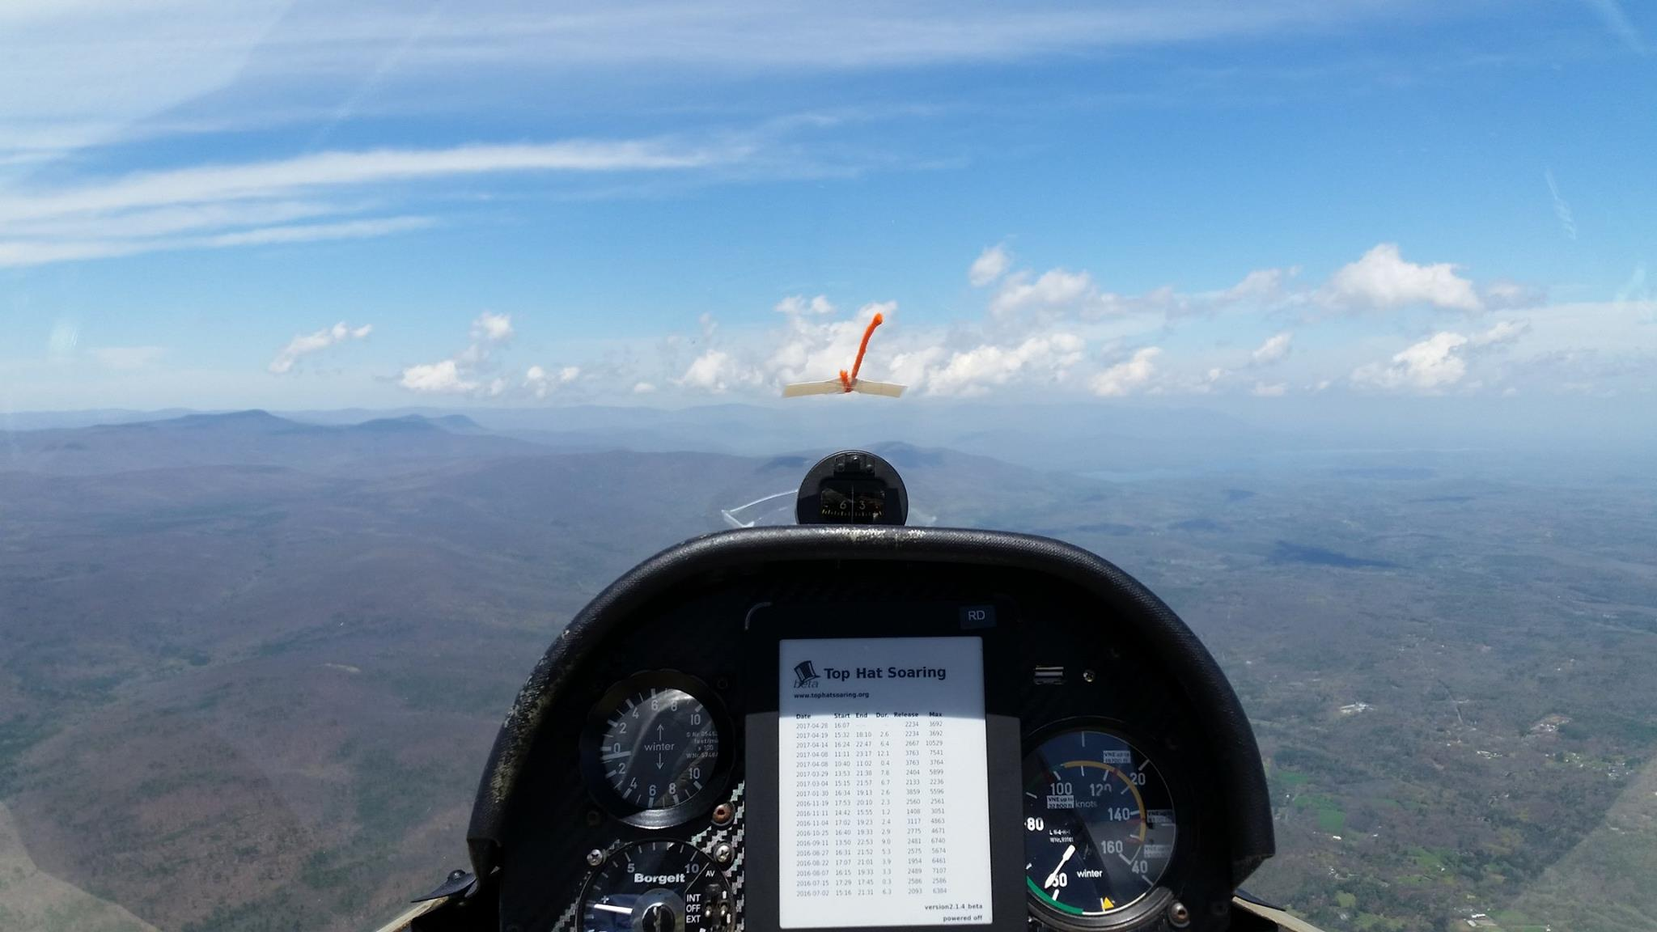

Slide 13
NW Ridge Forecasting (1/2)
  What do we look for:
    Wind Speed: 15-25 knots at ridge top
    Wind Direction: 290-360 Degrees
    Homogeneity of wind system
    Thermal forecast for transitions
    Where does the system end?

Slide 14
NW Ridge Forecasting (2/2)
Somewhat more crudely done because resolution is much less.
Tools:
  Long range: Windmapper. (Others use WindyTY)
    High or low pressure dominated system?
    Wind speed/direction
  Shorter range: Usairnet
  Blipmap
    Looking for 4000ft+ for transitions
    Homogeneity
    Where does system end?

Slide 15
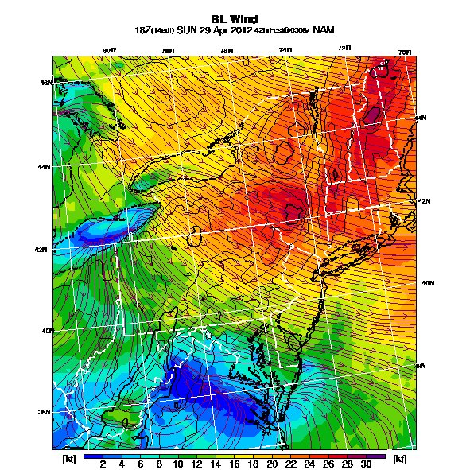

Slide 16
SE Ridge Forecasting (1/2)
SE Days are very finicky! Don’t trust forecasts more than 48 hours out.
The big questions are:
  Where is the rain going to be?
  Wind Direction/Wind Speed
  Cloudbase/ Height of overcast
  Thermals to make jump at pinnacle?

Slide 17
SE Ridge Forecasting (2/2)
“Back-end of High pressure SE”
Little wind, sunny, kicks on at the end of day. Generally very local.
Usually gets a little stronger at the end of the day.
Usually less than 10 knots at ridge top..
2. “Classic SE” –
Wind coming off of ocean 120-150 degrees.
High threat of rain, overcast. Usually no thermals.
On the property days.
The more Easterly it is, the closer the wall of rain will be.
“Hawkable”

Slide 18
SE Ridge Forecasting (2/2)
3. Continental SE- SW flow that is bent to 160 degrees or so.
Can be sunny, really awesome days.
These are somewhat more stable in forecasting.
Very small window for the sweet spot. Generally no rain.
Could go to the Tunnels/Beyond
4. “Sazhin SE”.
These days have wind that goes beyond 180 degrees.
The wind is usually weak or dead at Blairstown
  Wind gets stronger SW, peaking at Harrisburg.
No rain and consistent thermals
Limited by wind direction after Doubling Gap

Slide 19
Wave Forecasting
Review the “Soaring Blairstown wave” doc in the files section
Things ware looking for:
  Wind Direction- 280 degrees to 360 degrees
    (Sweet spot is probably around 280-300)
  15-20 knots at hydraulic jump
  Wind Gradient with altitude
  Stability
  Moisture: Lennies? Foehn gaps?
  We can find these things on a forecast sounding
  Wave forecasting beyond dawn is a complete crapshoot

Slide 20
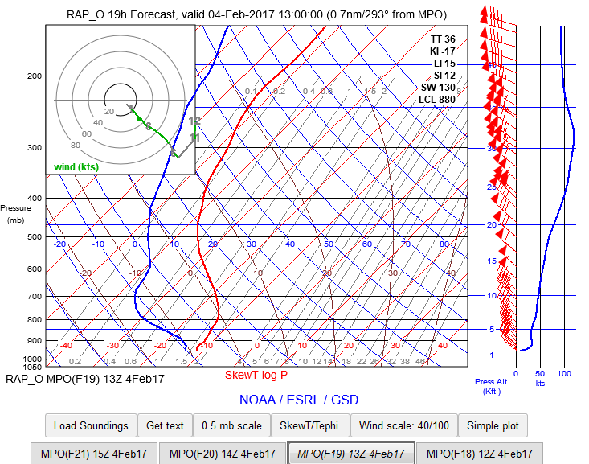

Slide 21
Useful links
  Windmapper
  Usairnet- Allentown/Mount Pocono etc.
  Dr.Jack
  TAFs- https://www.aviationweather.gov/taf?gis=off
  Skysight.io
  XCSkies
  NAM Pivotal – Long range NAM
  HRRR- Highly resolved NAM
  Precip data: https://water.weather.gov/precip/
  Forecast soundings: https://rucsoundings.noaa.gov/

