Slide 1
How To: Safety Final Glides
Daniel Sazhin

Slide 2
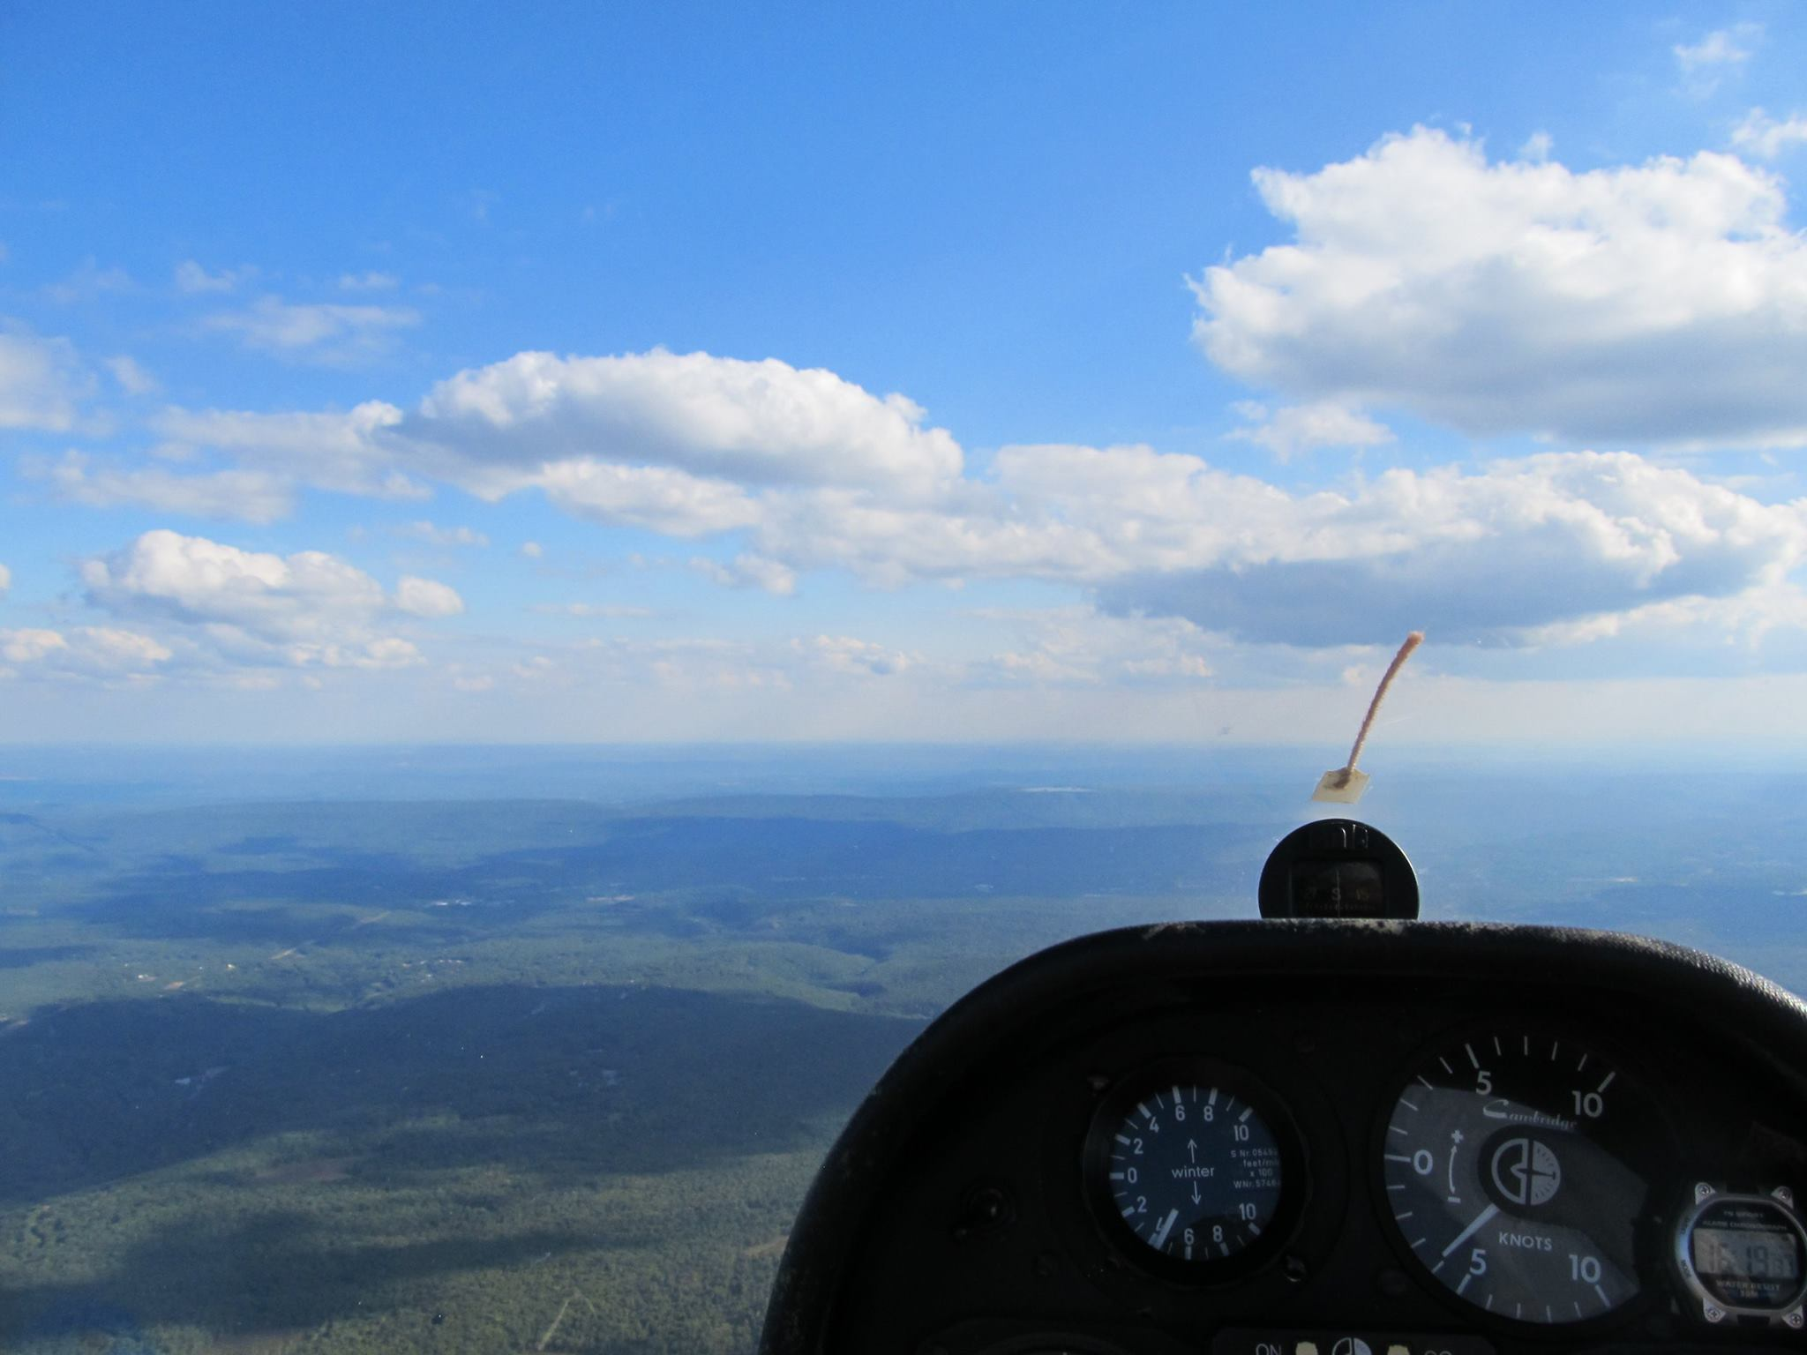
Can I make this glide?

Slide 3
Answer: It depends!
Factors to consider:
  Actual Polar
  Altitude
  Wind (Speed/Direction)
  Safety Margin
  Terrain
  Sink
  Bugs
  Rain

Slide 4
How do you make this calculation?
Mark I eyeball
Rules of thumb
Glide computers
Goal: Arrive safely at destination

Slide 5
Eyeball/ Rules of thumb
Look for the trend- Is the airport getting higher or lower?
Rules of thumb
  3 miles/ thousand ft in 1-26 (16-1)
  4 miles/ thousand ft in 1-34/Grob (21-1)
  5 miles/ thousand ft in LS3/LS4 (26.5-1)
Plan to arrive at pattern altitude + elevation above sea level

Slide 6
Why so “conservative”?
L/D of LS4 with 0 sink(40.4/1 at 52 knots)
  1 knot down- (22.8-1)
  2 knot down- (16-1)
  3 knot down- (12-1)
  4 knot down- (9.8-1)
Beware of big areas of sink- lee of ridge on a ridge day
Sink hurts you more when you have a final glide with a tailwind

Slide 7
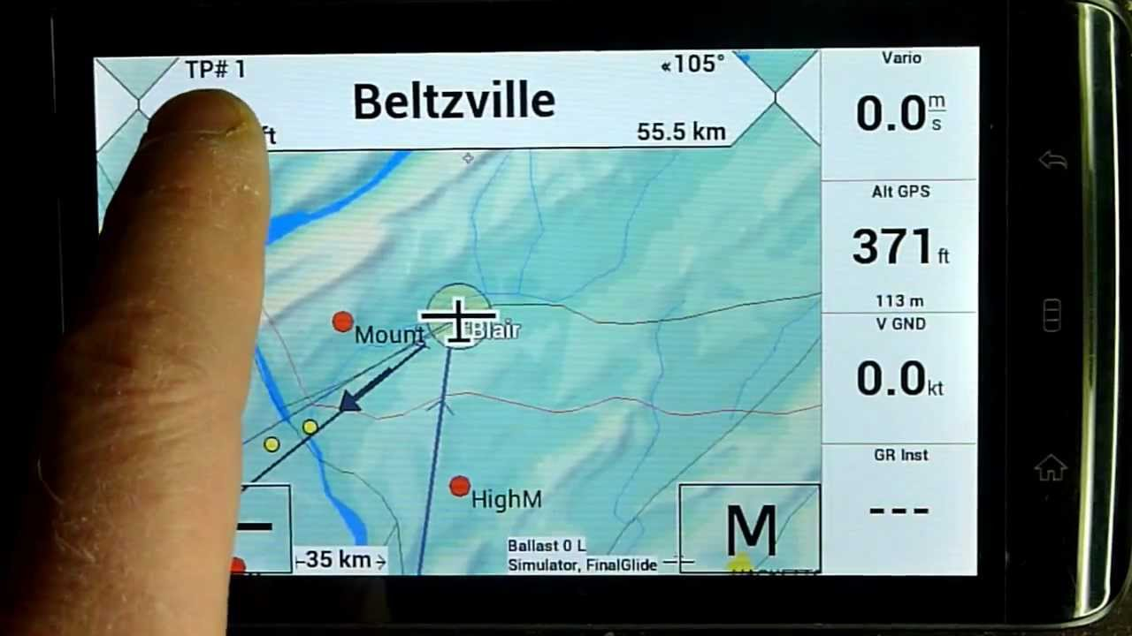
Glide Computer
Set up safe defaults
Understand features
Set MC for safe margin
(MC for glide vs. speed)
Set arrival altitude
Check calculations!!!

Slide 8
Glide Computer continued
LS4
  MC 3 ~ 6 miles/thousand ft
  MC 4 ~ 5.7 miles/thousand ft
  MC 5 ~ 5.5 miles/ thousand ft
This assumes no wind and polar adjustment
Use absolute minimum of MC 3 / 1000ft Arrival
Depends on long versus short glides
Set MC based on average climb strength of the day

Slide 9
Executing final glides
Once you have made the calculation, keep an eye on the trend
Do sanity check
Consider field options
Be more cautious getting to the bottom of the thermal band.
Know when you are completely committed- stop soaring
Speed up in sink!
  1-26 ~70 mph
  1-34R ~80 mph
  Greta ~70 knots
  LS3/4 ~80 knots

