Slide 1
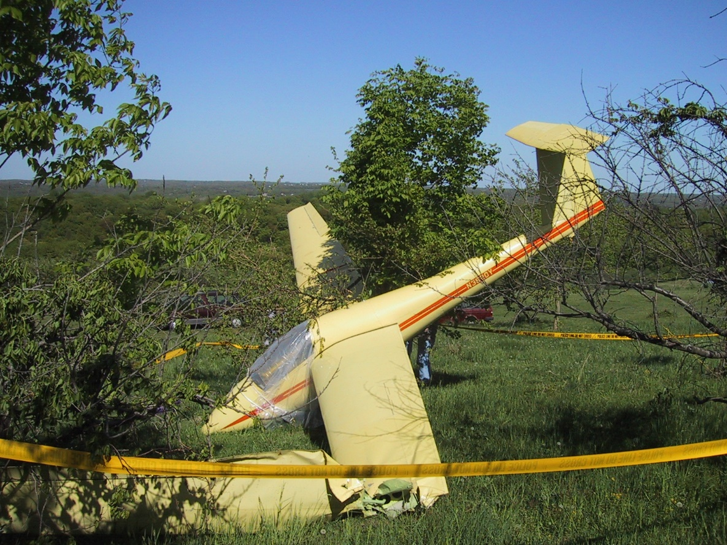
Operations and Safety
Safety Committee: Jonathan Leal, Rob Dunning and Daniel Sazhin

Slide 2
Legality and Club Guidelines
When is your Biennial Flight Review due?
Did you do three takeoffs and landings in the preceding 90 days?
  Club guidelines do not allow you to fly until you get a check-out with check pilot
  FAA does not allow flying with a passenger if not current
If you crash while flying out of BFR or with a passenger while not current, the insurance might not pay!
If you haven’t flown in a while or feel uncomfortable, speak up on the e-group and someone will accommodate.

Slide 3
Preflight (1/2)
Preflight is essential. These are club gliders! Something could be broken or different every time
Checklists available for each glider
If you are taking a glider after someone else, check independently. Just because they flew does not automatically make the glider airworthy!
Especially check
  Attachment bolts- Elevator, horizontal stabilizer, wings, ailerons, etc
  Tire pressure and skid condition
  Tip wheels/tail wheels
  Condition of seals

Slide 4
Preflight (2/2)
Issues in recent times:
  Rudder lock in glider (1-34R)
  TE Probe put in Pitot hole (Greta)
  Foam doodle on aileron pushrod (Red)
  Statics taped over (Red)
  Ballast weight in/out (1-34)
  Aileron lock on wing on grid (508)
  Stories from the crowd?
It can happen to you!

Slide 5
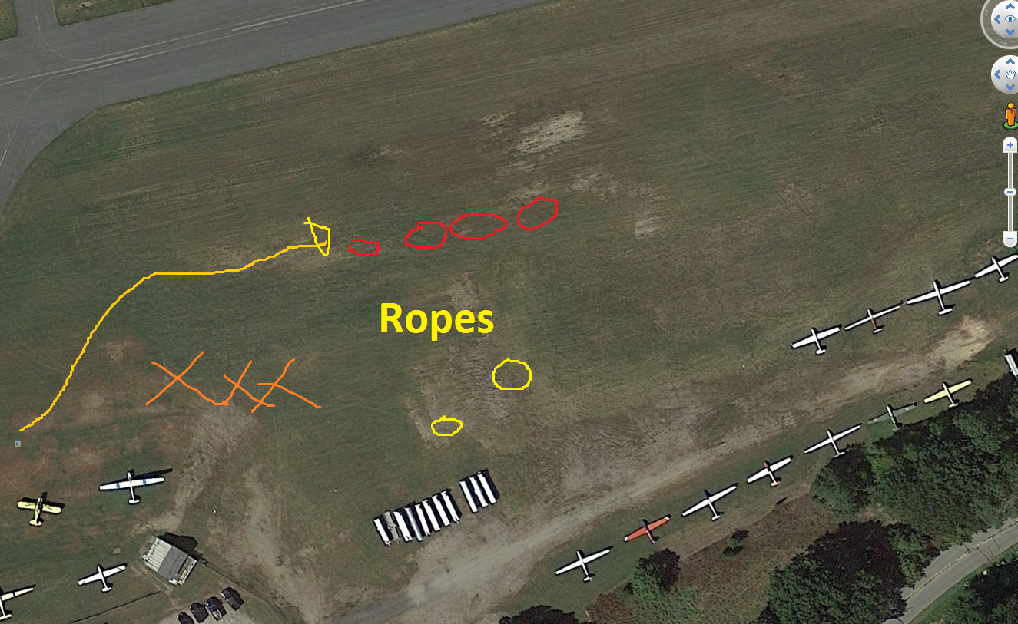
Ground Handling
Slow-walking pace
Go around the hill, not down the hill. If you go down the hill, don’t hold the wing back!
Tie spoilers open using belts
  (Insert B4 and 2-33 stories here)
Canopy always closed and locked
The most useless thing to a pilot is:______
Use tiedown ropes on the grid
  There are ropes available near the trailers for staging.
  Keep spoilers open on the grid

Slide 6
WingRunning
Do the course at: http://www.soaringsafety.org/learning/wingrunner/wingrunner.html
Specifics at Blairstown:
  Wait for the towplane to pass beyond the wing tip. Walk to the rope.
  Wait for the towplane to do its 180. Once it does, pick up the end of the rope and go to the glider
  Show the ring to the pilot. Use big ring for Schweizers and extension for glass.
  Hook-up. Then go to the wingtip
  Look around for airplane and glider traffic in the pattern or staging.
  When the slack is out, look at the pilot and thumbs up.
  Lift wing by the tip of the trailing edge. Look for towplane rudder waggle, then glider waggle.
  Wave arm in circular manner. RUN with the wing. Don’t push against the pilot.
Until you lift the wing and wave your arm, you’re the boss of the operation! If you see unsafe condition on glider, towplane or possible traffic, PUT THE WING DOWN!

Slide 7
Takeoff
Get in the glider when third on the grid. Be completely ready when the towplane comes to you.
Make sure to do pre-takeoff checklist. Usually available on the panel.
  I do: Altimeter Set, Belts on and Secure, Controls checked, Divebrakes closed and locked, Flaps set for takeoff, Trim set, Canopy closed and locked, Emergency plan
You’re the boss. If in doubt, release!
Once rolling, get the glider as soon as practicable off of the ground.

Slide 8
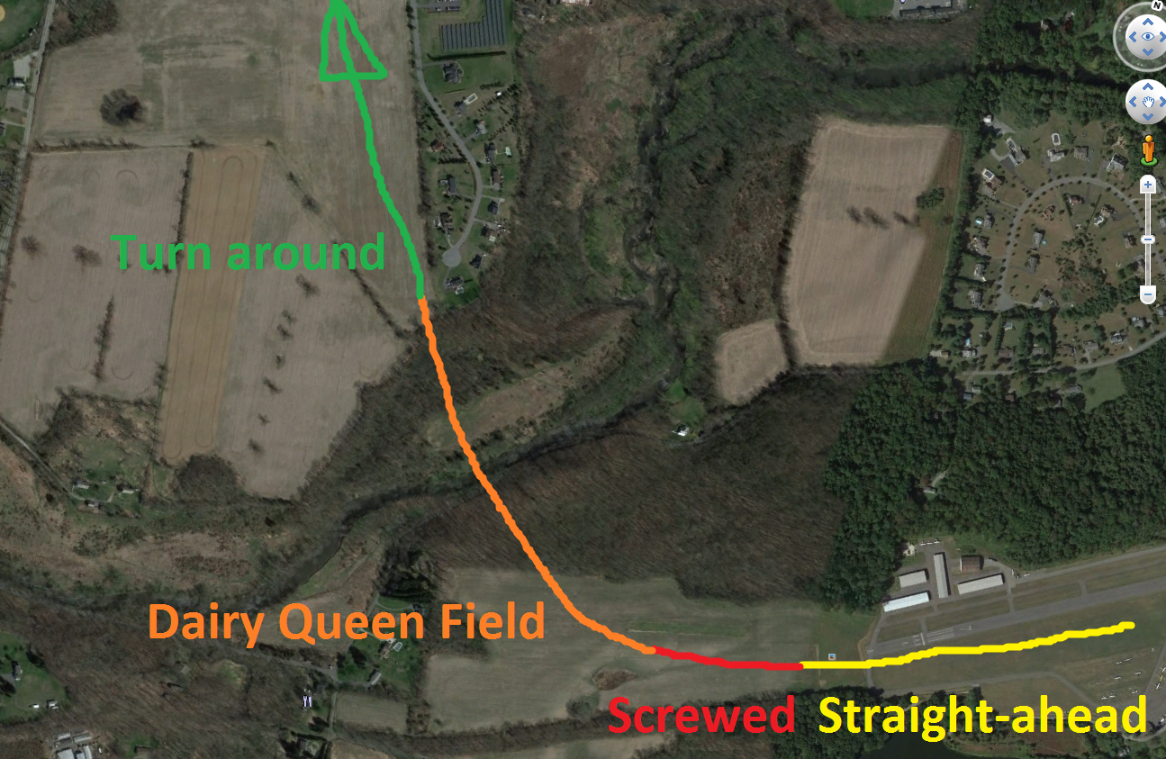
Tow
Do you have an emergency plan?
Trees are better than 180 below 200ft!
200ft is bare minimum for turn around.
  Usually safer to go higher
Don’t get high on the towplane! Release if out of sight
Look left and right before releasing. Turn right after release.

Slide 9
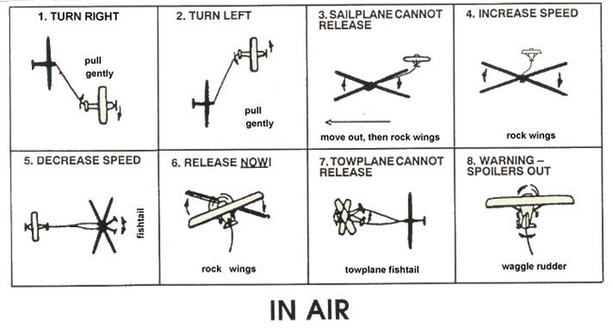
Towplane Signals

Slide 10
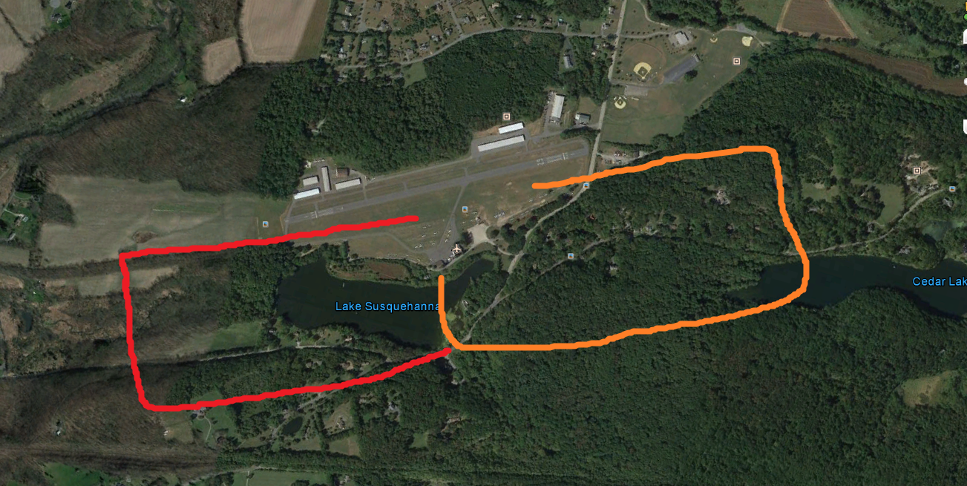
Pattern
What’s going to kill you in flying? Hitting the ground!
Make the decision to land when you have energy.
Keep a safe amount of energy in altitude and airspeed in the approach
Gliders have great airbrakes. Use ‘em!
Watch out for airplane and glider traffic
If practicable, announce downwind

Slide 11
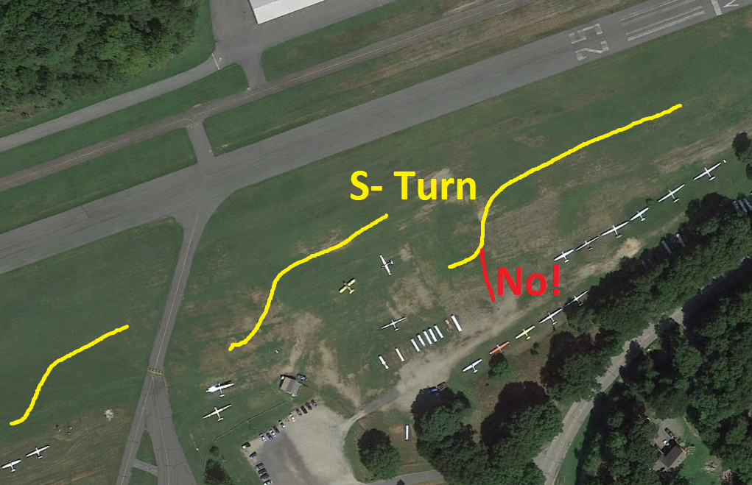
Landing
Avoid rolling over the taxiway if possible. Land before or after.
No shame in going long!
Land with as little energy as practicable
When on the ground, fly to a stop!!!!
  Stick should be all the way back
  Taxi off of the runway
  Don’t point at anything expensive
Don’t use excessive braking. Don’t trust the wheelbrake
When stopped, get out and pull the glider off of the runway!

Slide 12
Miscellaneous
When you see someone need to launch or get off the runway, help!
If something is unsafe or broken, let others know.
Stay safe!

